Slide 1
P5 - Unit 1 - Lesson 4 - Digital Colors
Patti, Jerusha, Saranii

Slide 2
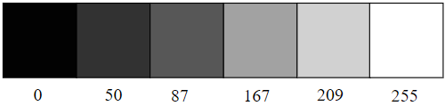
Let’s take a look at color in Digital Format:
We first look at grayscale colors. Notice that we begin at 0 which is black and then go up to 255 which is white and all of the color shades in between.

Slide 3
Function Background:
Take a look in the Function background section in the P5 editor. You will notice the number 220. This is a light shade of gray. Now try to change the color using the gray scale code which is one number from 0-255 and see what happens. What do you notice about the change in the background?

Slide 4
Functions of stroke() and fill()
By adding the function of stroke(0); this sets the outline (stroke) to black
By adding fill(150); this adds the color to the inside of a shape.
By adding the shape last to the code, the shape will fill in and have the the stroke/outline that you want.
Caution, if you list the shape first and then the stroke and fill afterwards, the color will not fill in your shape.

Slide 5
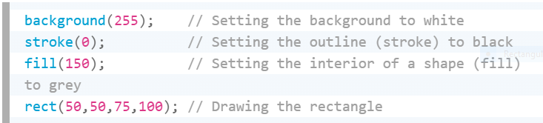
Sample code for Stroke() and Fill()

Slide 6
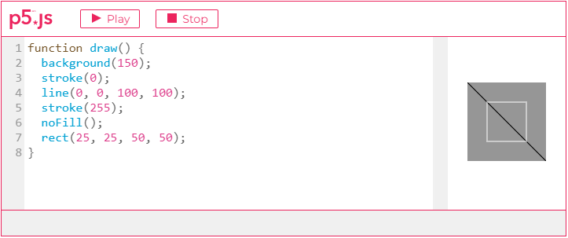
Function of noStroke() and noFill()
First thing to remember is that we do not want to eliminate both noStroke() and noFill() or nothing will appear.
Whatever fill and stroke you have most recently written will be used for any subsequent shapes unless you state so directly in your code. As seen here in this example.

Slide 7
RGB Color
We use primary colors of R(ed), G(reen) and B(lue), in other words RGB
Red + Green = Yellow
Red + Blue = Purple
Green + Blue = Cyan (blue-green)
Red + Green + Blue = White
No colors = Black
These are just the basics.

Slide 8
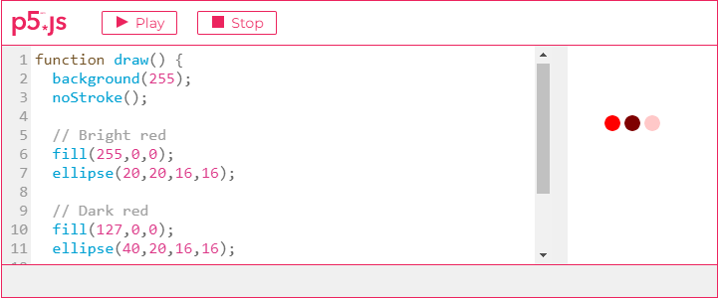
RGB Colors (cont’d)
Each of the colors R, G and B have a range of 0-255. When we combine these different values in the parenthesis for the color function, we can get a different variety of colors. For example fill(123, 43, 233) This gives us different values in each category. You can experiment and will get the hang of it. You can also use a color palette found on many different web pages, but we will use this one: HTML COLOR CODES See RGB example below. Try it in your P5 editor.

Slide 9
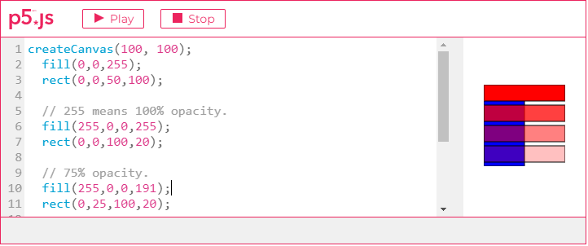
RGB Color Transparency
Besides RGB, you can add a fourth component known as the color’s “alpha” which means transparent. This enables the shapes or sketches to appear see through. Pixels are not really transparent, they just present an illusion by the blending of the colors.
Alpha values also range from 0-255 with 0 being completely transparent or 0% opaque, and 255 being completely opaque. See example below:

Slide 10
Custom Color Ranges
We can look at color like percentage and use a specific custom colorMode(;
In this case we use colorMode(RGB, 100); This looks at 100%, and you can have ranges:
colorMode(RGB, 100, 500, 10, 255) This means R would go from 0-100, G from 0-500, blue from 0-10 and alpha from 0-255
We can also use Hue, Saturation and Brightness but not needed
Hue ranges from 0 to 360 - color type
Saturation - ranges 0 to 100 - vibrancy of color
Brightness - 0-100 - brightness of the color

Slide 11
Assignment
Click on the file for P5 and follow the instructions to create and fill several shapes in the P5 editor. Use the RGB color values you want where indicated.
Use the transparent, alpha code where indicated
Use the colorMode where indicated.
Make sure to sign in with Google and then click on File→ Duplicate before working on the file. Make sure you save your work.
Here is the sketch to work on.
https://editor.p5js.org/pelfers-truth/sketches/2rVeyc2eR

Slide 12
Reference
https://p5js.org/learn/color.html
http://htmlcolorcodes.com

